Slide 1
Project presentation on
Micro Credit Defaulter
Submitted by :
Anshul dubey
Internship Batch no:- 28

Slide 2
Table Of Contents
1.Introduction
i. Business Problem Framing
Ii .Conceptual Background of the Domain Problem
Iii. Review of Literature
iv.Motivation for the Problem Undertaken
2.Analytical Problem Framing
i.Data Sources and their formats
ii.Data Pre-processing Done
iii.Data Inputs- Logic- Output Relationships
iv.Set of assumptions related to the problem under consideration
v.Hardware and Software Requirements and Tools Used
3.Model/s Development and Evaluation
i.Identification of possible problem-solving approaches (methods)
ii.Testing of Identified Approaches (Algorithms)
iii.Run and Evaluate selected models
iv.Key Metrics for success in solving problem under consideration
v.Interpretation of the Results
4.Conclusion
i.Key Findings and Conclusions of the Study
ii.Learning Outcomes of the Study in respect of Data Science
iii.Limitations of this work and Scope for Future Work
5.5. Acknowledgement

Slide 3
INTRODUCTION
Business Problem Framing
A Microfinance Institution (MFI) is an organization that offers financial services to low income populations. MFS becomes very useful when targeting especially the unbanked poor families living in remote areas with not much sources of income.
They understand the importance of communication and how it effects a person’s life and lack of communication can cause lot of uncertain problems, thus, focusing on providing their services and products to low income families and poor customers that can help them in the need of hour.

Slide 4
Conceptual Background of the Domain Problem
MFS are collaborating with an MFI to provide micro-credit on mobile balances to be paid back in 5 days. The Consumer is believed to be defaulter if he deviates from the path of paying back the loaned amount within the time duration of 5 days. For the loan amount of 5 (in Indonesian Rupiah), payback amount should be 6 (in Indonesian Rupiah), while, for the loan amount of 10 (in Indonesian Rupiah), the payback amount should be 12 (in Indonesian Rupiah).

Slide 5
Review of Literature
•The Microfinance services (MFS) provided by MFI are Group Loans, Agricultural Loans, Individual Business Loans and so on. Many microfinance institutions (MFI), experts and donors are supporting the idea of using mobile financial services (MFS) which they feel are more convenient and efficient, and cost saving, than the traditional high-touch model used since long for the purpose of delivering microfinance services. Though, the MFI industry is primarily focusing on low income families and are very useful in such areas, the implementation of MFS has been uneven with both significant challenges and successes.
•Today, microfinance is widely accepted as a poverty-reduction tool, representing $70 billion in outstanding loans and a global outreach of 200 million clients.

Slide 6
Motivation for the Problem Undertaken
We understand the importance of communication and how it effects a person’s life and lack of communication can cause lot of uncertain problems so we want to work in order to bridge this gap between people.
We are working with one such client that is in Telecom Industry. They are a fixed wireless telecommunications network provider. They have launched various products and have developed its business and organization based on the budget operator model, offering better products at Lower Prices to all value conscious customers through a strategy of disruptive innovation that focuses on the subscriber.

Slide 7
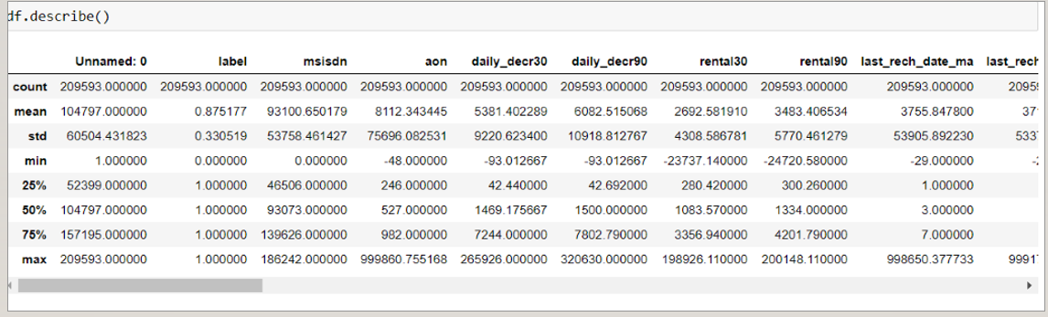
Analytical Problem Framing
Mathematical/ Analytical Modelling of the Problem
We first look into the statistics of data shown in fig 1.

Slide 8
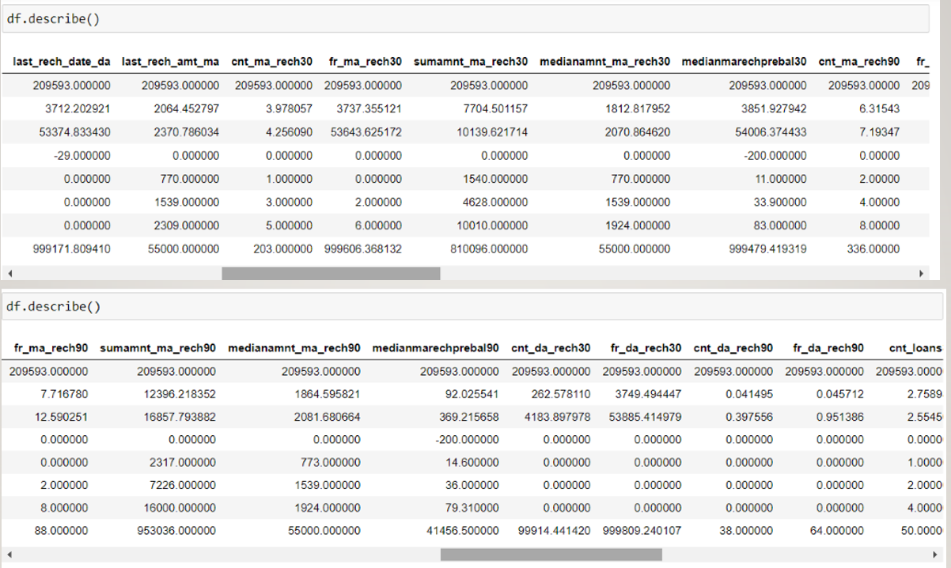

Slide 9
Statistical description of data
From this statistical analysis we make some of the interpretations that,
1.Maximum standard deviation is observed in aon column.
2.In the columns aon, daily_decr30, daily_decr90, rental90, last_rech_date_ma, last_rech_date_da, maxamnt_loans30, cnt_loans90, amnt_loans90, rental30 mean is considerably greater than median so the columns are positively skewed.
3.In the columns label, month median is greater than mean so the columns are negatively skewed.
4.In the columns aon, daily_decr30, daily_decr90, rental30, rental90, last_rech_date_ma, last_rech_date_da, maxamnt_loans30, cnt_loans90, payback30, payback90 there is huge difference present between 75th perecentile and maximum so outliers are present here.

Slide 10
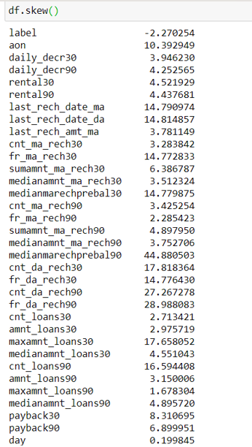
We look for the skewness present in data

Slide 11
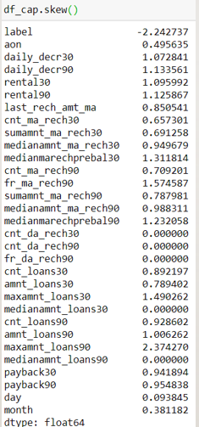
We observe skewness in the data due to outliers so we remove the 7-8% outliers through zscore method by keeping standard deviation 5 and treat the rest outliers through winsorization technique. Now the skewness observed is:

Slide 12
Data Sources and their formats
The variable features of this problem statement are :-
Variable : Defination -> comment label : Flag indicating whether the user paid back the credit amount within 5 days of issuing the loan{1:success, 0:failure}
msisdn : mobile number of user
aon : age on cellular network in days
daily_decr30 : Daily amount spent from main account, averaged over last 30 days (in Indonesian Rupiah)
daily_decr90 : Daily amount spent from main account, averaged over last 90 days (in Indonesian Rupiah)
rental30 : Average main account balance over last 30 days -> Unsure of given definition
rental90 : Average main account balance over last 90 days -> Unsure of given definition
last_rech_date_ma : Number of days till last recharge of main account
last_rech_date_da : Number of days till last recharge of data account

Slide 13
Sources
•last_rech_amt_ma : Amount of last recharge of main account (in Indonesian Rupiah)
•cnt_ma_rech30 : Number of times main account got recharged in last 30 days
•fr_ma_rech30 : Frequency of main account recharged in last 30 days -> Unsure of given definition
•sumamnt_ma_rech30 : Total amount of recharge in main account over last 30 days (in Indonesian Rupiah)
•medianamnt_ma_rech30 : Median of amount of recharges done in main account over last 30 days at user level (in Indonesian Rupiah)
•medianmarechprebal30 : Median of main account balance just before recharge in last 30 days at user level (in Indonesian Rupiah)
•cnt_ma_rech90 : Number of times main account got recharged in last 90 days
•fr_ma_rech90 : Frequency of main account recharged in last 90 days -> Unsure of given definition
•sumamnt_ma_rech90 : Total amount of recharge in main account over last 90 days (in Indonasian Rupiah)
•medianamnt_ma_rech90 : Median of amount of recharges done in main account over last 90 days at user level (in Indonasian Rupiah)
•medianmarechprebal90 : Median of main account balance just before recharge in last 90 days at user level (in Indonasian Rupiah)
•cnt_da_rech30 : Number of times data account got recharged in last 30 days
•fr_da_rech30 : Frequency of data account recharged in last 30 days
•cnt_da_rech90 : Number of times data account got recharged in last 90
•fr_da_rech90 : Frequency of data account recharged in last 90 days
•cnt_loans30 : Number of loans taken by user in last 30 days
•amnt_loans30 : Total amount of loans taken by user in last 30 days

Slide 14
Sources
maxamnt_loans30 : maximum amount of loan taken by the user in last 30 days -> There are only two options: 5 & 10 Rs., for which the user needs to pay back 6 & 12 Rs. respectively
medianamnt_loans30 : Median of amounts of loan taken by the user in last 30 days
cnt_loans90 : Number of loans taken by user in last 90 days
amnt_loans90 : Total amount of loans taken by user in last 90 days
maxamnt_loans90 : maximum amount of loan taken by the user in last 90 days
medianamnt_loans90 : Median of amounts of loan taken by the user in last 90 days
payback30 : Average payback time in days over last 30 days
payback90 : Average payback time in days over last 90 days
pcircle : telecom circle
pdate : date

Slide 15
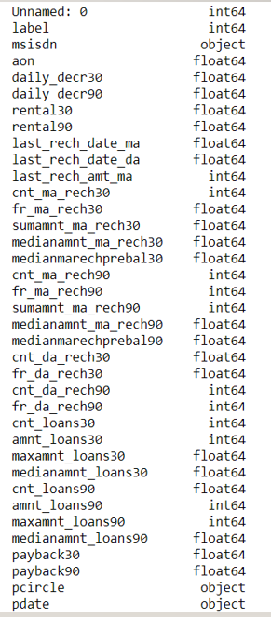
The data types of features

Slide 16
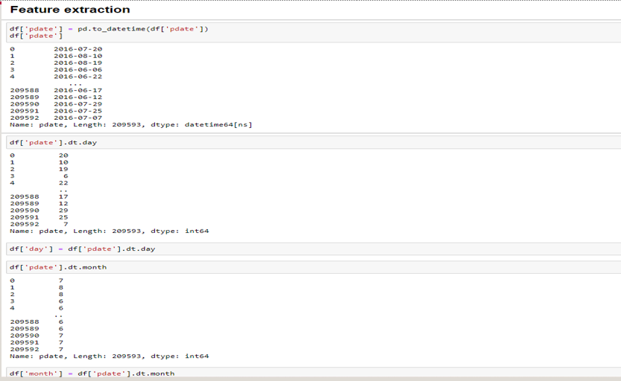
Data Preprocessing
We first done data cleaning. In data cleaning we done feature extraction, we extracted the features day and month from pdate column

Slide 17
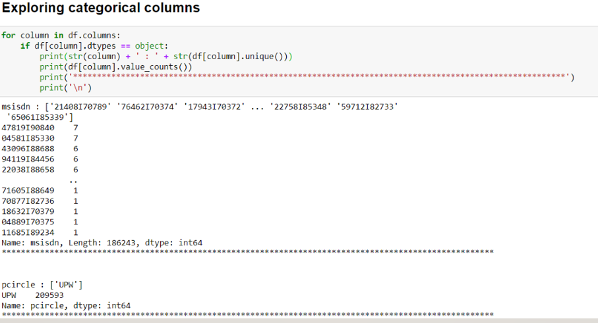
We then explored categorical variables

Slide 18
We observed that there is only one unique value present in pcircle column which is ‘UPW’ so will be dropping this column. Then we observed that column msisdn was present in categorical column so we encode it to numbers using label encoder as shown in fig 7, to check it’s correlation with other feature variables and target varaible
We then checked the heatmap of correlaton. while checking the heatmap of correlation we observed that there exists multicollinearity in between columns.
We also observed that no correlation was present in unnamed: 0, msisdn , last_rechdate_ma, last_rechdate_da columns so we will be dropping these columns.
We then removed the outliers from the dataset through zscore and winsorization method.

Slide 19
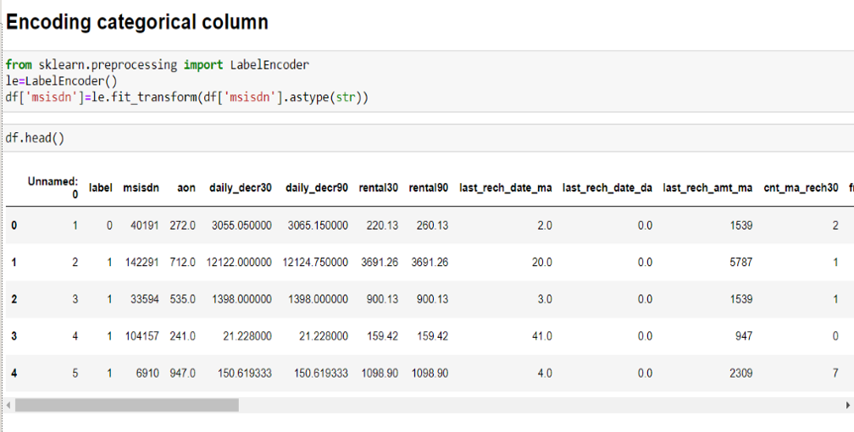
Encoding

Slide 20
Data Inputs- Logic- Output Relationships
Here we check the correlation between all our feature variables with target variable label
•We observe that the columns cnt_ma_rech30 and cnt_ma_rech90 are highly positively correlated with label this means as the cnt_ma_rech30 and cnt_ma_rech90 are increasing the probability of cutomer being non-fraudulent is also increasing.
•We also observe that the columns aon, medianmarechprebal30 and fr_da_rech90 are negatively correlated with label this means as the aon, medianmarechprebal30 and fr_da_rech90 are increasing the probability of customer being fraudulent is also increasing.

Slide 21
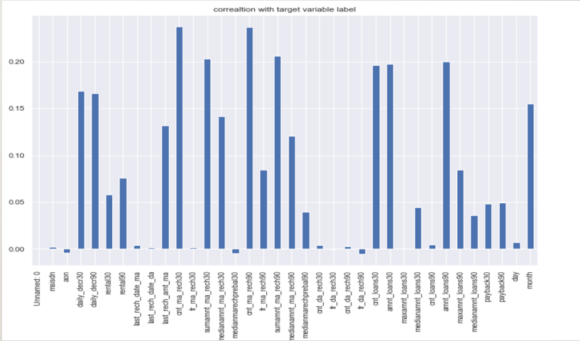

Slide 22
Model/s Development and Evaluation
Identification of possible problem-solving approaches
We first converted all our categorical variables to numeric variables with the help of label encoder to checkout the correlation between them and dropped the columns which we felt were unnecessary.
We observed skewness in data so we tried to remove the skewness through treating outliers with winsorization technique as shown in fig 3.
The data was imbalanced so through imblearn’s SmoteTomek package we were able to handle the imbalanced data by increasing the number of fraudulent transactions on relevant data points.
The data was improper scaled so we scaled the feature vaariables on a single scale using sklearn’s StandardScaler package.
There were too many (37) feature variables in the data so we reduced it to 7 with the help of Principal Component Analysis(PCA) by plotting Eigenvalues and taking the number of nodes as our number of feature variables.

Slide 23
Testing of Identified Approaches (Algorithms)
The algorithms we used for the training and testing are as follows:-
Extreme gradient boosting classifier
Decision tree classifier
KNeighbors classifier
Logistic Regression
GaussianNB
Random forest classifier
Ada boost classifier
GradientBoostingClassifie
Bagging classifier
Extra trees classifier

Slide 24
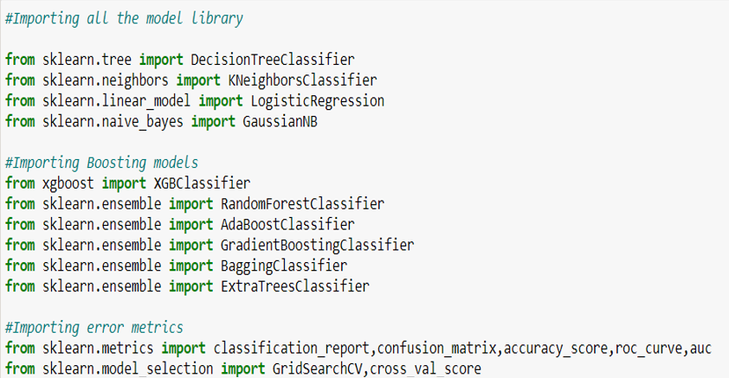
Run and Evaluate selected models
The algorithms we used are

Slide 25
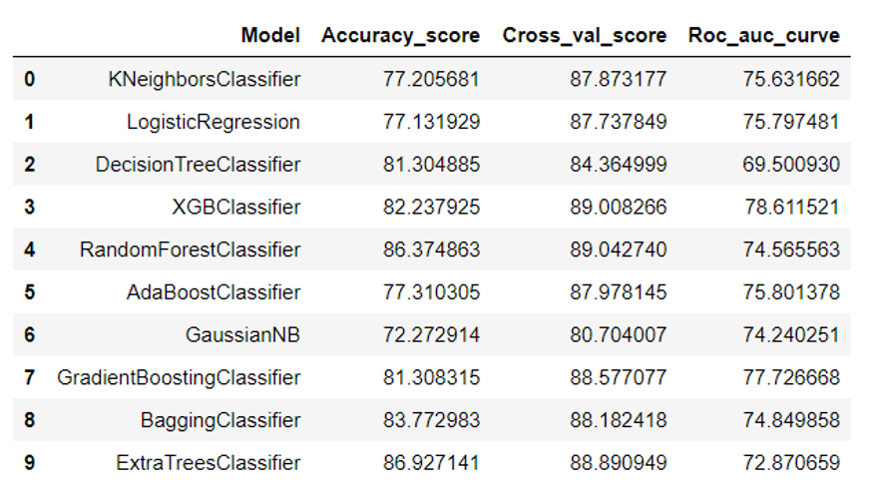
The results observed over different evaluation metrics

Slide 26
Key Metrics for success in solving problem under consideration
Accuracy is not a appropriate measure of model performance here and we used the metric AREA UNDER ROC CURVE to evaulate models performance because high rocscore will mean high recall which means the model does well by not classifying legit transactions as fraudulent.

Slide 27
Interpretation of the Results
From the visualization we interpreted that the data was very imbalanced and the target variable was highly positively correlated with the columns cnt_ma_rech30 and cnt_ma_ma_rech90.
From the preprocessing we interpreted that data was improper scaled, there were hidden features present in the data which needed to be extracted.
From the modeling we interpreted that XGBClassifier works best with respect to our model with rocscore 0.90

Slide 28
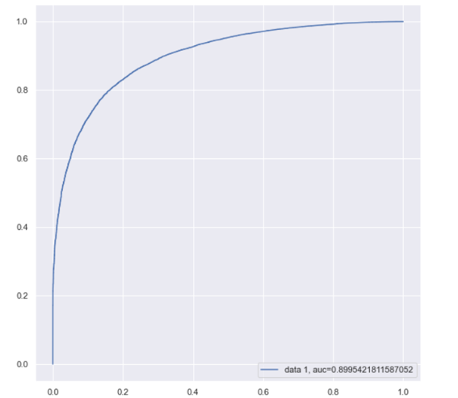
auc roc curve using XGBClassifier

Slide 29
CONCLUSION
Key Findings and Conclusions of the Study
In this project we have tried to show how to deal with unbalanced datasets like the MicroCreditDefaulter where the instances of fraudulent cases is few compared to the instances of non fraudulent cases. We have argued why accuracy is not a appropriate measure of model performance here and used the metric AREA UNDER ROC CURVE to evaluate how method of SmoteTomek technique can lead to better model training.
The best score of 0.90 was achieved using the best parameters of XGBClassifier through GridSearchCV though both random forest and gradient boosting models performed well too.

Slide 30
Learning Outcomes of the Study in respect of Data Science
This project has demonstrated the importance of sampling effectively, modelling and predicting data with an imbalanced dataset.
Through different powerful tools of visualization we were able to analyse and interpret different hidden insights about the data.
Through data cleaning we were able to remove unnecessary columns and outliers from our dataset due to which our model would have suffered from overfitting or underfitting.

Slide 31
Few challenges
•The few challenges while working on this project were:-
•Improper scaling
•Too many features
•Hidden features
•Imbalanced data
•Skewed data due to outliers
•The data was improper scaled so we scaled it to a single scale using sklearns’s package StandardScaler.
•There were too many(37) features present in the data so we applied Principal Component Analysis(PCA) and found out the Eigenvalues and on the basis of number of nodes we were able able to reduce our features upto 7 columns.
•There were hidden features present in pdate column so we converted the column in datetime format in order to extract day and month column by doing feature extraction.
•The data was imbalanced so we handled the unbalanced data through SmoteTomek technique by creating more number of fraudulent cases on relevant data points.
•The columns were skewed due to presence of outliers which we handled through winsorization technique

Slide 32
Thanking You

